Slide 1
Zone Defense
Building resilient infrastructure across availability zones
Cheuk Lau
2018 DevOps Fellow
Insight Data Science, Palo Alto CA

Slide 2
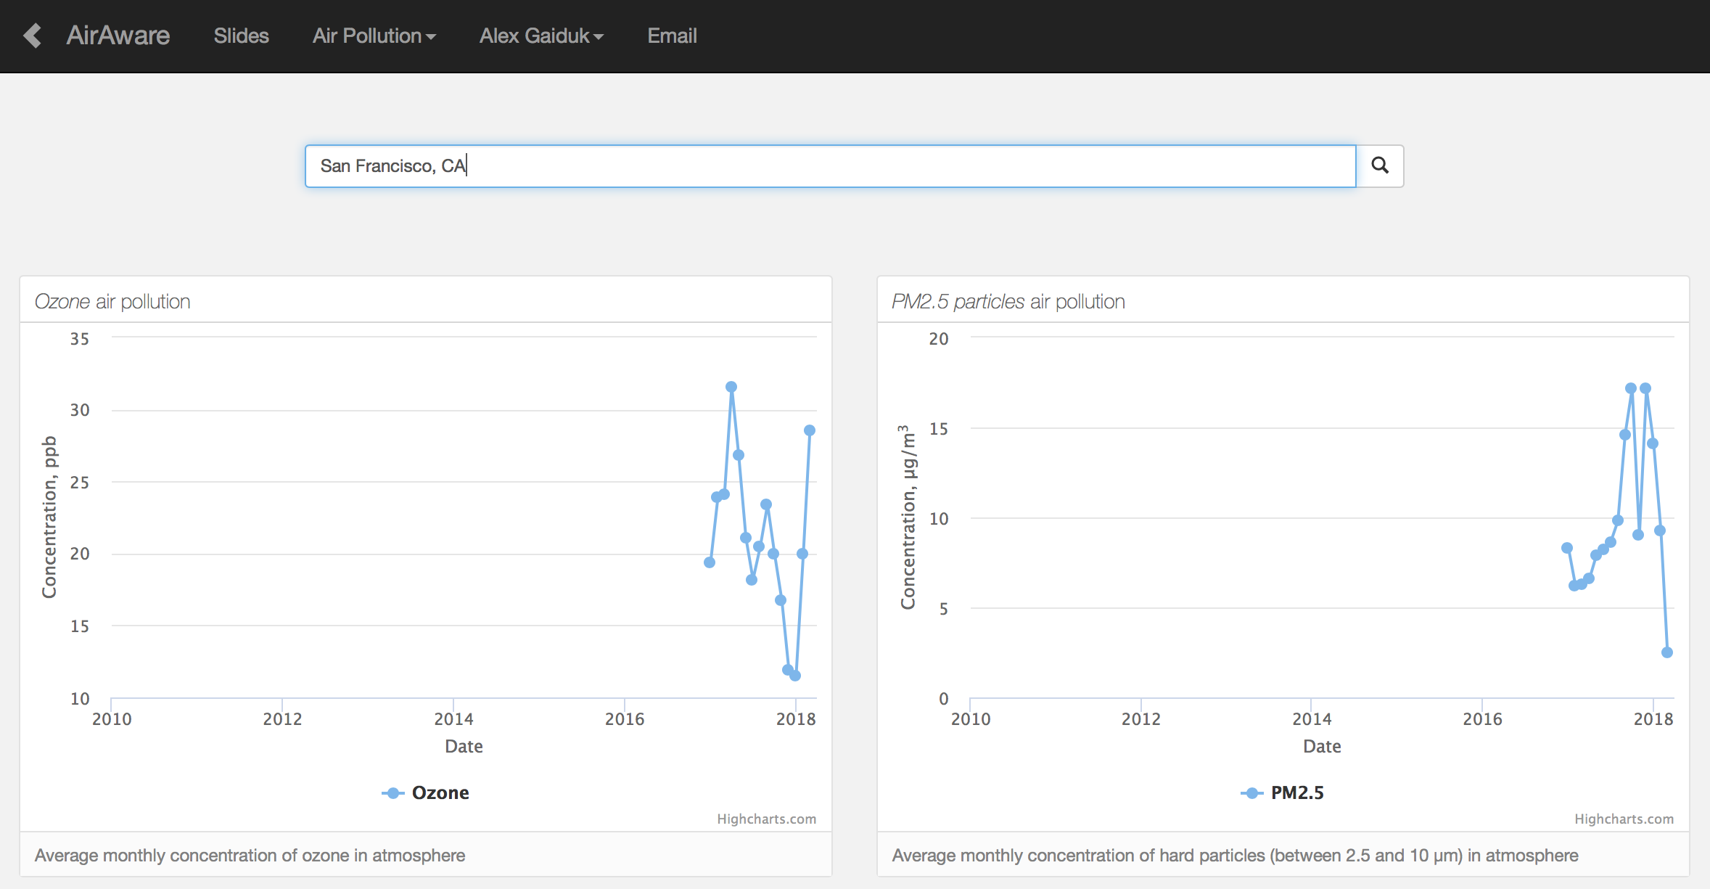

Great app, but manual deployment is painful

Slide 3
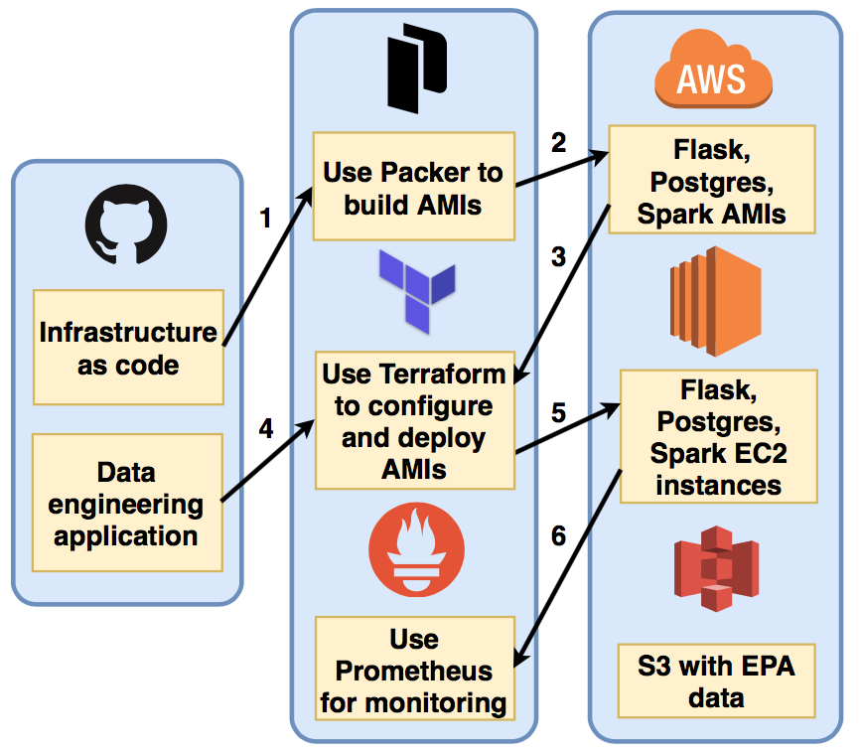
Infrastructure as code
Deploy and monitor with the click of a button

Slide 4
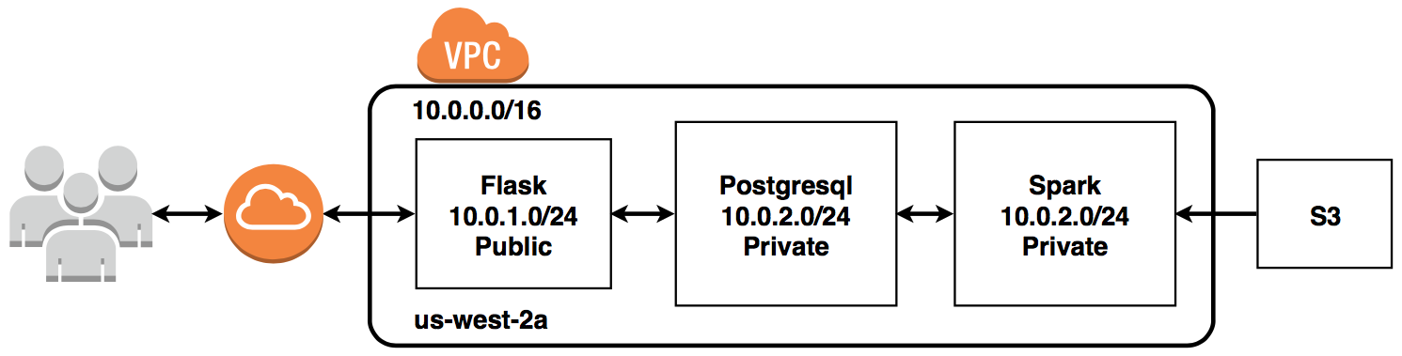
Baseline infrastructure has poor reliability...

Slide 5
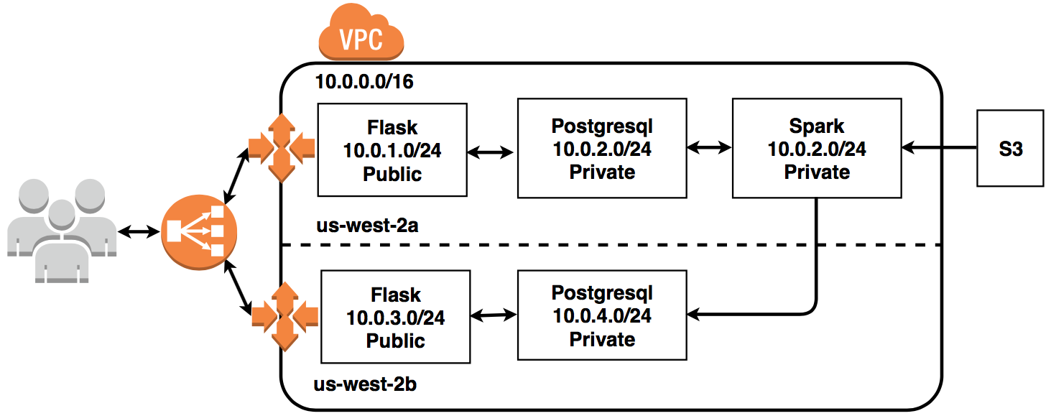
...so I added auto-scaling across multiple availability zones

Slide 6
Demo: Traffic Spike
Link to screencast

Slide 7
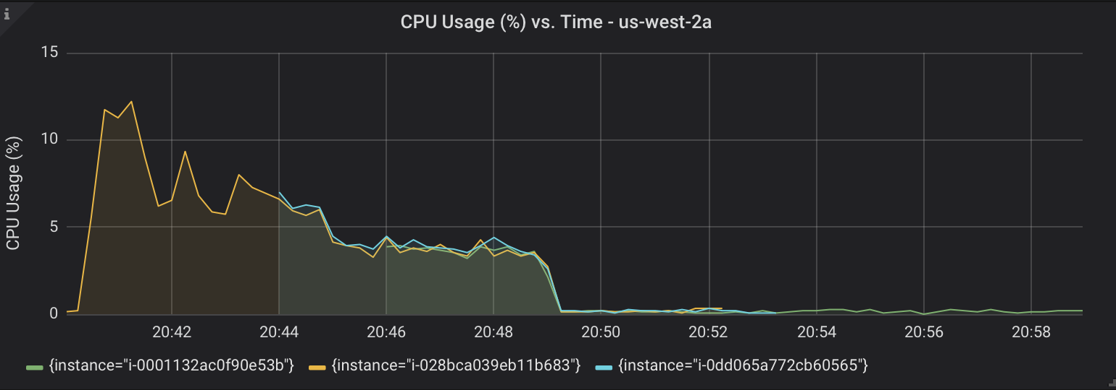
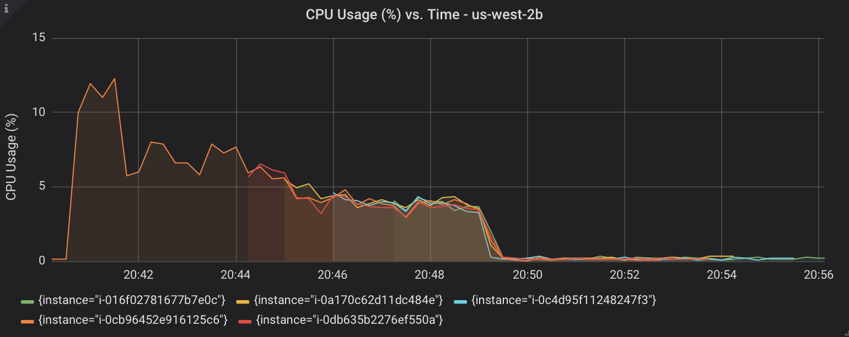
Start Locust
1000 users
w/ 3 rps
Server 2 on
Server 3 on
Stop Locust
Server 3 Remains
Server 2 Off
Server 1 Off
Upper
Lower
Upper
Lower

Slide 8
Demo: Availability Zone Outage
Link to screencast

Slide 9
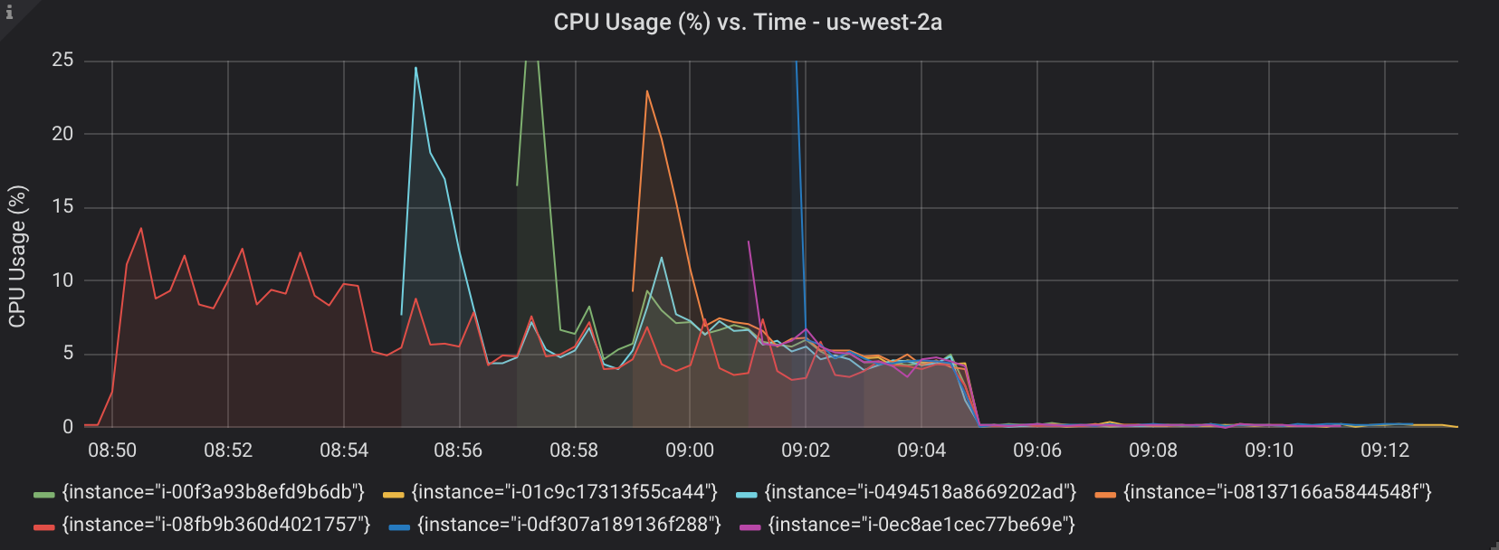
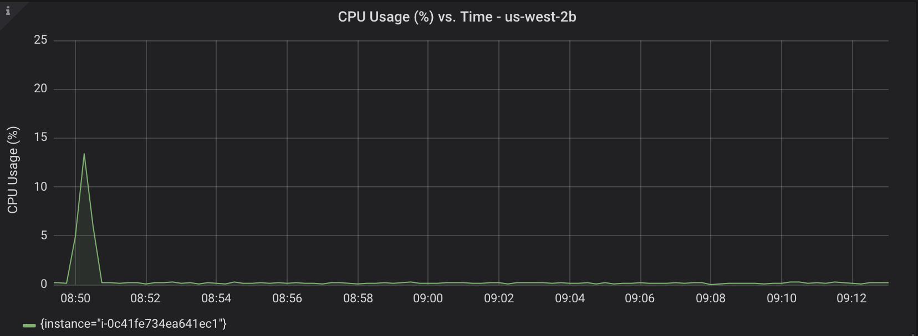
Start Locust
1000 users
w/ 3 rps
~2x over previous
Stop Locust
Spin down to one server
Upper
Lower
Cut off us-west-2b
Server 7 on
Server 2 on
Server 6 on
Server 3 on
Server 5 on
Server 4 on
Start Locust
1000 users
w/ 3 rps

Slide 10

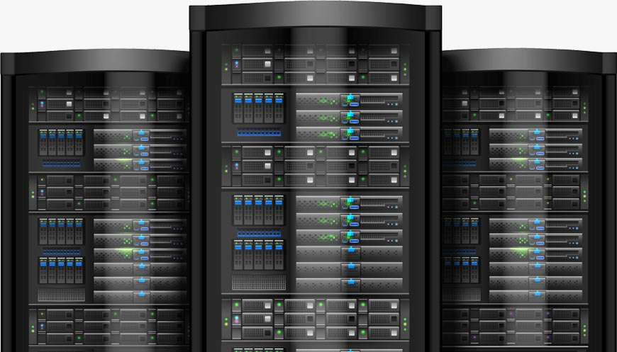
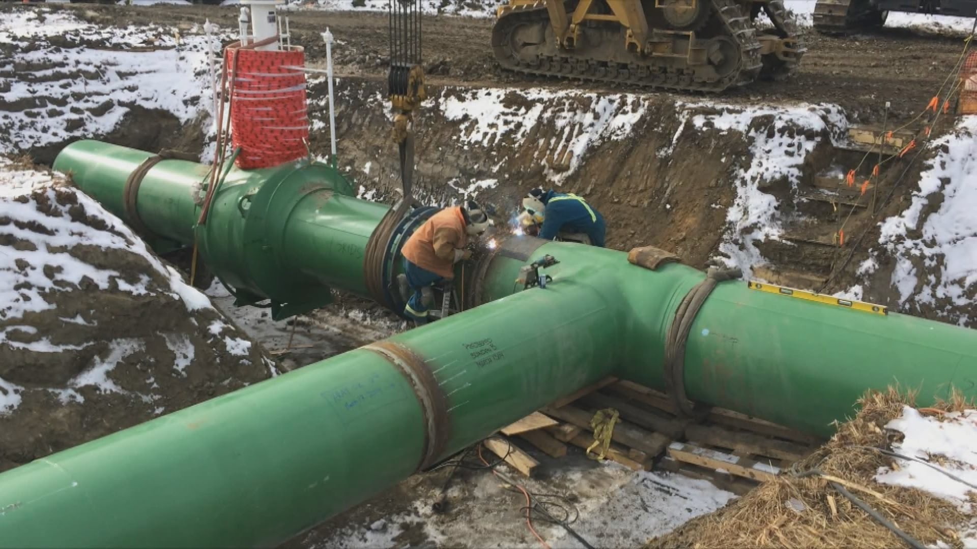
AirAware can now be automatically deployed to a highly reliable infrastructure

Slide 11



About Me
Ph.D nuclear engineering from Texas A&M University.
Last role at Lawrence Livermore Lab as a computational physicist.
Hobbies include traveling with my wife and training my pug.
Recently made it on America’s Funniest Home Video!

Slide 12
Questions?

Slide 13
Backup Slides

Slide 14
VMs vs. Containers
We have only used VMs not containers.
Alternatively, we can spin up a VM to host Docker engine and run multiple containers.
Each container can have one or more apps.
This might be more feasible for Flask as we need to quickly spin them up/down to meet user demand.
Containers may not be beneficial for Spark or Postgres.

Slide 15
CI/CD
Developer to customer pipeline:
Build → Test → Release → Provision/Deploy
Terraform and Packer takes care of Release → Provision/Deploy.
We can use CI tools (e.g., Jenkins) for Build → Test.
Entire developer to customer pipeline can be executed whenever a developer pushes new features.

Slide 16
Multi-Region and Multi-Cloud
Adds an additional layer of reliability, but at additional cost and complexity.

